Slide 2
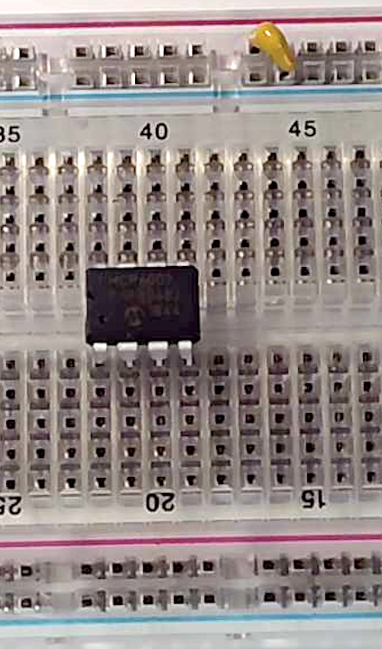
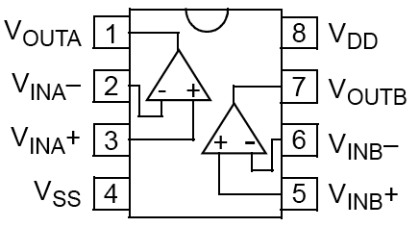

0.1uF
Decoupling
capacitor
5V
5V
0.1uF
MCP6002
notch
Pin 1
GND

Slide 3
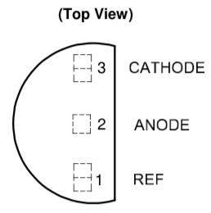
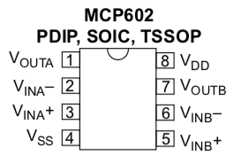

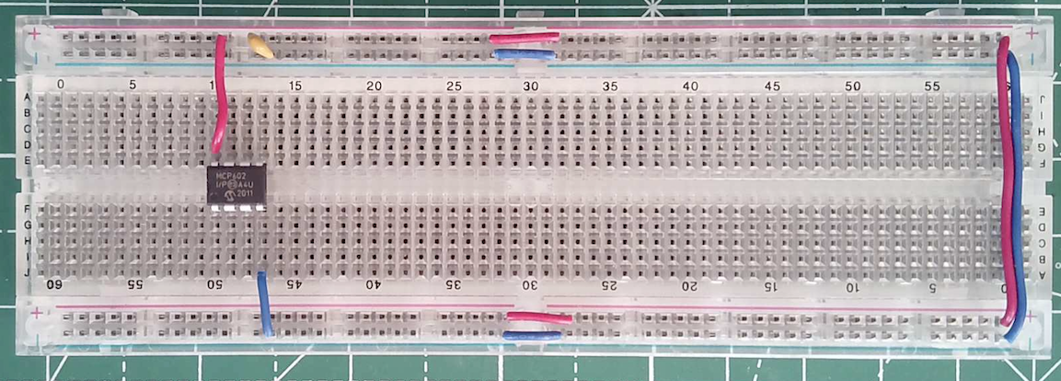
5V
1μ
0.1μ
C2
3
8
C1
+
V1
V_{G}
½ MCP
6002
1
2
4
R3
220k
R2
270
220k
5V
2.5v
R4
R1
4.7k
GRN
AP431i
C3
10m
R13
100
Notes:
On the breadboard is a small 8-pin chip, the LM386, which is a special audio amplifier designed to drive speakers such as the one you have. Connect this according to the circuit shown.
The LM386 is NOT an op-amp. It is an amplifier where the resistors to fix the gain is already inside the chip. Again you can download the datasheet of the LM386 from the course webpage.
This audio amplifier is designed to work with a single power supply. It does not need an external 2.5V voltage reference because it provides that for itself internally on the chip. Its input range is ±0.4V, and the default voltage gain is +20dB (x 10).
Construct this circuit and apply the 440Hz tone to the input. You will find that it is now NOT distorted at the output and the speaker provides a pure done to your ears.

Slide 4
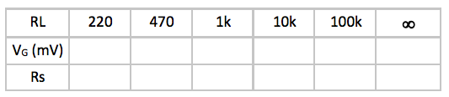

PicoScope
R_{S}
BNC cable
Vs
V_{G}
R_{L}
+
=
2.5V DC
10kHz sine wave
1.65V peak-to-peak
2.5V DC offset
+
Vs
-
10kHz sine wave
1.65V peak-to-peak
Vcc = 5v
Pin 1
0.1μ
3
8
C1
V_{G}
+
V1
Vo
½ MCP6002
1
10kHz sine wave
1V peak-to-peak
1V DC offset
200k
2
R3
4
R2
Mount resistor on adjacent pins vertically
200k

Slide 5
Vcc = 5v
0.1μ
3
8
C1
V_{G}
+
Vo
V1
½ MCP6002
1
10kHz sine wave
1V peak-to-peak
1V DC offset
200k
2
R3
4
R2
68k
200k
R1

Slide 6
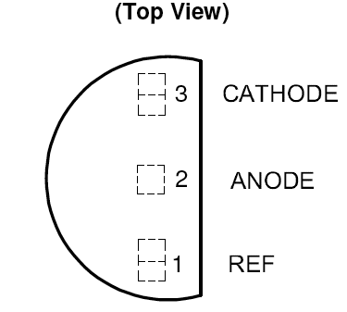
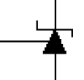
Vcc = 5v
200k
C2
R4
0.1μ
1μ
3
8
C1
V_{G}
+
V1
1
Vo
0.01μ
200k
½ MC6002
10kHz sine wave
1V peak-to-peak
1V DC offset
2
C4
R3
4
R2
68k
200k
R1
+
10u
C3
220
5V
2.5V reference
AP431i
R4
3
AP431i
cathode
ref
1
anode
2

Slide 7
5V
1u
C2
0.1u
3
8
C1
V_{G}
+
V1
10kHz sine wave
1V peak-to-peak
1V DC offset
½ MCP6002
1
2
4
220
5V
R2
R4
+2.5V
R3
200k
200k
3
R1
68k
cathode
+
10u
1
ref
AP431i
C3
anode
2

Slide 8
5V
1u
C2
0.1u
V_{G}
3
8
C1
sine wave
2V peak-to-peak
1V DC offset
100Hz – 100kHz
R5
+
V1
100k
½ MCP6002
1
R6
2
1k
4
R3
R2
+2.5V
Vref
200k
200k
R1
2k
+
10u
C3

Slide 9
5V
100k
1u
C2
0.1u
R10
V_{G}
3
8
C1
R5
+
V1
10k
100k
½ MCP6002
1
6
V₂
R6
R9
2
7
1k
4
½ MCP6002
2.5V
Vref
+
R2
5
5V
2.5V
Vref
R3
200k
200k
R1
10k
+
10u
C3
8Ω
Notes:
On the breadboard is a small 8-pin chip, the LM386, which is a special audio amplifier designed to drive speakers such as the one you have. Connect this according to the circuit shown.
The LM386 is NOT an op-amp. It is an amplifier where the resistors to fix the gain is already inside the chip. Again you can download the datasheet of the LM386 from the course webpage.
This audio amplifier is designed to work with a single power supply. It does not need an external 2.5V voltage reference because it provides that for itself internally on the chip. Its input range is ±0.4V, and the default voltage gain is +20dB (x 10).
Construct this circuit and apply the 440Hz tone to the input. You will find that it is now NOT distorted at the output and the speaker provides a pure done to your ears.

Slide 10
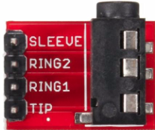

5V
5V
100k
10k
R7
1u
C2
0.1u
8
C1
R10
3
+
Audio Mic
V1
10k
½ MCP6002
1
6
V₂
R9
C8
2
7
+
4
½ MCP6002
2.5V
Vref
5
470μ
2.5V
Vref
R3
R2
200k
200k
R1
10k
+
10u
C3
8Ω
Notes:
On the breadboard is a small 8-pin chip, the LM386, which is a special audio amplifier designed to drive speakers such as the one you have. Connect this according to the circuit shown.
The LM386 is NOT an op-amp. It is an amplifier where the resistors to fix the gain is already inside the chip. Again you can download the datasheet of the LM386 from the course webpage.
This audio amplifier is designed to work with a single power supply. It does not need an external 2.5V voltage reference because it provides that for itself internally on the chip. Its input range is ±0.4V, and the default voltage gain is +20dB (x 10).
Construct this circuit and apply the 440Hz tone to the input. You will find that it is now NOT distorted at the output and the speaker provides a pure done to your ears.

Slide 11
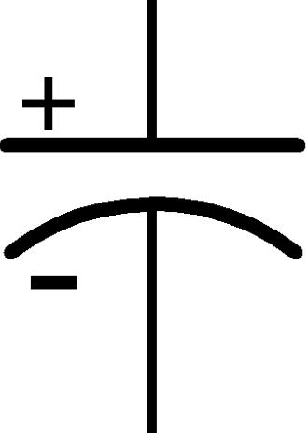
5V
C4
1u
0.1u
V_{G}
3
6
C5
+
V3
480μ
sine wave
0.4V peak-to-peak
0V DC offset
5
+
LM386
2
8Ω
4
C6
C8
47n
R6
10
Notes:
On the breadboard is a small 8-pin chip, the LM386, which is a special audio amplifier designed to drive speakers such as the one you have. Connect this according to the circuit shown.
The LM386 is NOT an op-amp. It is an amplifier where the resistors to fix the gain is already inside the chip. Again you can download the datasheet of the LM386 from the course webpage.
This audio amplifier is designed to work with a single power supply. It does not need an external 2.5V voltage reference because it provides that for itself internally on the chip. Its input range is ±0.4V, and the default voltage gain is +20dB (x 10).
Construct this circuit and apply the 440Hz tone to the input. You will find that it is now NOT distorted at the output and the speaker provides a pure done to your ears.

Slide 12
5V
5V
100k
10k
R7
1u
C2
0.1u
R10
3
8
C1
+
V1
10k
Audio Mic
1
5
½ MCP6002
R9
+
V_{B}
2
7
4
5V
½ IC1
6
D3
2.5V
Vref
R3
R2
R11
200k
10k
100
R12
200k
R1
10k
470μ
+
+
10u
C3
5V
C8
8
5V
270
2.5V
C4
1u
0.1u
R4
3
6
C5
Peak detector
Vref
+
V_{D}
5
V2
1N914
D4
D1
LM386
AP431i
2
D2
10k
R5
4
C6
R13
C7
100
47n
10k
R8
1u
R6
10
Notes:
On the breadboard is a small 8-pin chip, the LM386, which is a special audio amplifier designed to drive speakers such as the one you have. Connect this according to the circuit shown.
The LM386 is NOT an op-amp. It is an amplifier where the resistors to fix the gain is already inside the chip. Again you can download the datasheet of the LM386 from the course webpage.
This audio amplifier is designed to work with a single power supply. It does not need an external 2.5V voltage reference because it provides that for itself internally on the chip. Its input range is ±0.4V, and the default voltage gain is +20dB (x 10).
Construct this circuit and apply the 440Hz tone to the input. You will find that it is now NOT distorted at the output and the speaker provides a pure done to your ears.

Slide 13
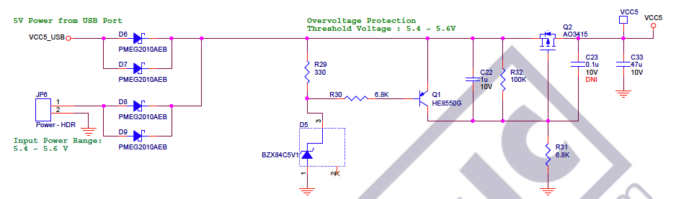
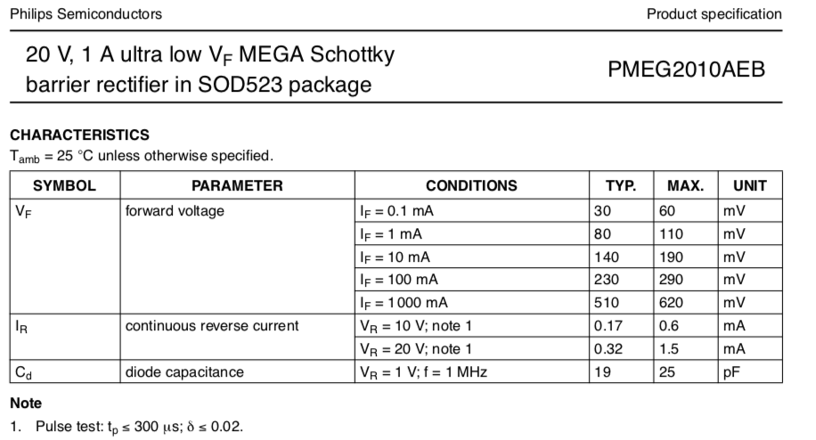
Notes:
On the breadboard is a small 8-pin chip, the LM386, which is a special audio amplifier designed to drive speakers such as the one you have. Connect this according to the circuit shown.
The LM386 is NOT an op-amp. It is an amplifier where the resistors to fix the gain is already inside the chip. Again you can download the datasheet of the LM386 from the course webpage.
This audio amplifier is designed to work with a single power supply. It does not need an external 2.5V voltage reference because it provides that for itself internally on the chip. Its input range is ±0.4V, and the default voltage gain is +20dB (x 10).
Construct this circuit and apply the 440Hz tone to the input. You will find that it is now NOT distorted at the output and the speaker provides a pure done to your ears.

Slide 14
5V
5V
10k
R7
1u
C2
0.1u
3
8
C1
+
V1
Audio Mic
1
½ IC1
2
4
2.5V
Vref
R3
R2
200k
200k
R1
10k
+
10u
C3
Notes:
On the breadboard is a small 8-pin chip, the LM386, which is a special audio amplifier designed to drive speakers such as the one you have. Connect this according to the circuit shown.
The LM386 is NOT an op-amp. It is an amplifier where the resistors to fix the gain is already inside the chip. Again you can download the datasheet of the LM386 from the course webpage.
This audio amplifier is designed to work with a single power supply. It does not need an external 2.5V voltage reference because it provides that for itself internally on the chip. Its input range is ±0.4V, and the default voltage gain is +20dB (x 10).
Construct this circuit and apply the 440Hz tone to the input. You will find that it is now NOT distorted at the output and the speaker provides a pure done to your ears.

Slide 15
5V
5V
100k
10k
R7
1u
C2
0.1u
R10
3
8
C1
+
V1
10k
Audio Mic
1
5
½ IC1
R9
+
V_{B}
2
7
4
5V
½ IC1
6
D3
2.5V
Vref
R3
R2
R11
200k
10k
100
R12
200k
R1
10k
470μ
+
+
10u
C3
5V
C8
8
5V
270
2.5V
C4
1u
0.1u
R4
3
6
C5
Peak detector
Vref
+
V_{D}
5
V2
1N914
D4
D1
IC2
AP431i
2
D2
10k
R5
4
C6
R13
C7
100
47n
10k
R8
1u
R6
10
Notes:
On the breadboard is a small 8-pin chip, the LM386, which is a special audio amplifier designed to drive speakers such as the one you have. Connect this according to the circuit shown.
The LM386 is NOT an op-amp. It is an amplifier where the resistors to fix the gain is already inside the chip. Again you can download the datasheet of the LM386 from the course webpage.
This audio amplifier is designed to work with a single power supply. It does not need an external 2.5V voltage reference because it provides that for itself internally on the chip. Its input range is ±0.4V, and the default voltage gain is +20dB (x 10).
Construct this circuit and apply the 440Hz tone to the input. You will find that it is now NOT distorted at the output and the speaker provides a pure done to your ears.

Slide 16
C9
1n
5V
47k
47k
0.1μ
3
8
C11
R14
R15
+
V5
Vs
½ IC3
1
C10
2
1n
4
Notes:
On the breadboard is a small 8-pin chip, the LM386, which is a special audio amplifier designed to drive speakers such as the one you have. Connect this according to the circuit shown.
The LM386 is NOT an op-amp. It is an amplifier where the resistors to fix the gain is already inside the chip. Again you can download the datasheet of the LM386 from the course webpage.
This audio amplifier is designed to work with a single power supply. It does not need an external 2.5V voltage reference because it provides that for itself internally on the chip. Its input range is ±0.4V, and the default voltage gain is +20dB (x 10).
Construct this circuit and apply the 440Hz tone to the input. You will find that it is now NOT distorted at the output and the speaker provides a pure done to your ears.

Slide 17
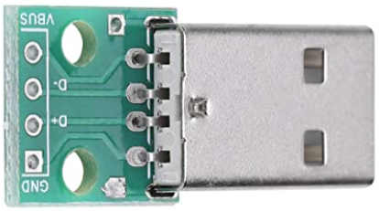
Twisted wire (RED & BLUE) about 50cm long – single or multi-core, flexible preferred
BLUE
GND
R100
5V
RED
RXEF025
D100
SB120
Notes:
On the breadboard is a small 8-pin chip, the LM386, which is a special audio amplifier designed to drive speakers such as the one you have. Connect this according to the circuit shown.
The LM386 is NOT an op-amp. It is an amplifier where the resistors to fix the gain is already inside the chip. Again you can download the datasheet of the LM386 from the course webpage.
This audio amplifier is designed to work with a single power supply. It does not need an external 2.5V voltage reference because it provides that for itself internally on the chip. Its input range is ±0.4V, and the default voltage gain is +20dB (x 10).
Construct this circuit and apply the 440Hz tone to the input. You will find that it is now NOT distorted at the output and the speaker provides a pure done to your ears.

